Slide 1









ASTRONOMIX
TEAM:INFINITY8
( PUNJAB ENGINEERING COLLEGE )

Slide 2


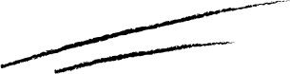
CHALLENGE OVERVIEW: BUILD PREDICTIVE MODELS THAT CAN DETERMINE WHETHER AN ASTEROID IS ON A
COLLISION COURSE WITH EARTH OR NOT.
ASTEROID COLLISION PREDICTOR

Slide 3


HERE'S A STEP-BY-STEP GUIDE ON HOW TO APPROACH THIS PROBLEM:

Slide 4
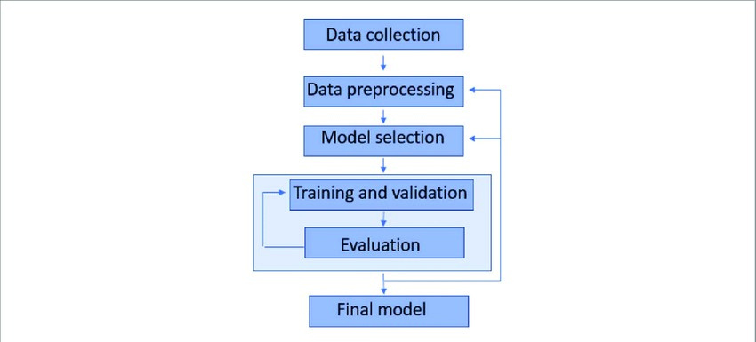

Objectives

Slide 5





Step 1: Importing the dependencies
PANDAS :pandas is a fast,powerful, flexible and easy to use open source data analysis and manipulation tool, built on top of the Python programming language.
MATPLOTLIB:Matplotlib is a comprehensive library for creating static, animated, and interactive visualizations in Python.
SKLEARN:Scikit-learn (Sklearn) is the most useful and robust library for machine learning in Python.
NUMPY:NumPy is a Python library used for working with arrays.It also has functions for working in domain of linear algebra, fourier transform, and matrices.

Slide 6

Step 2: Data Collection and Processing
Loading the dataset to a pandas Dataframe.
Checking number of rows and columns
Analyze the distribution of Data.
We found a null element in Dataset(Asteroid Magnitude).
We filled up the null space by Imputation(by Median)!!
Determined the Feature and Target Datatype to be achieved

Slide 7

Step 3: Splitting the features and target
So here we found that our target data type is ’Hazardous’.
Then we cleaned and Dataprocessed our target. We made two variables X and Y, having numerical dataset and target dataset respectively.

Slide 8






Step 4: Splitting the data into training and test data.
Creating train and test data variables in X and Y.
Verifying shape of data variables in X and Y.
Verifying standard deviation of X and Y.

Slide 9
Step 5: Hyper Parameter Training
Applying logistic regression to the dataset.
Training the logistic regression model with training data.
Verifying accuracy score on training data.
Accuracy score on training data = 88.25516 %
Verifying accuracy score on testing data.
Accuracy score on testing data = 88.39142 %
Therefore no condition of overfitting.

Slide 10
Step 6: Building a predictive system
Changing the input data to a numpy array.
It helps us to reshape the input data.
Reshape the numpy array as we are predicting only one data point.
So if prediction is false, our model prints “Collision doesn’t occurs.” , otherwise our model prints “ Collision occurs.”

Slide 11
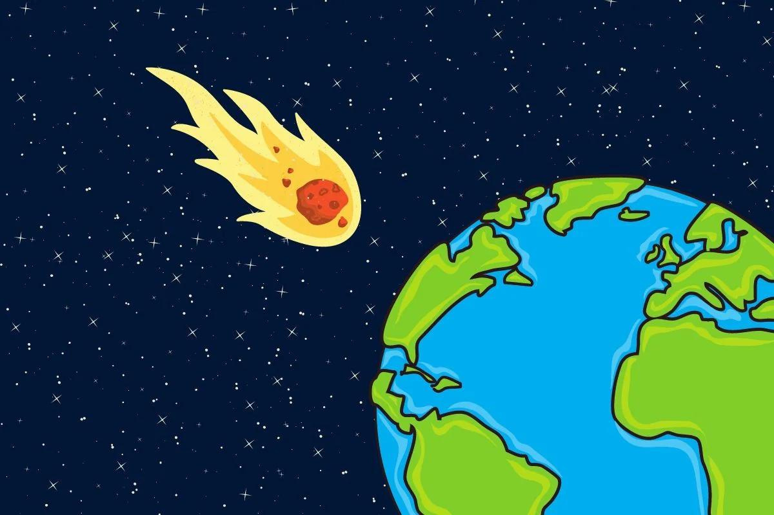




Conclusion
Through the Model, based on the Orbital
Data provided , we can estimate the
collision probability of Asteroids with
high accuracy upto 88-90%.

Slide 12

Contributed By:-
Priyanshu
Sahil Kumar
Varun Pratap Singh
PUNJAB ENGINNERING COLLEGE

